Slide 1
Computational Linguistics

Slide 2

Natural Language
Languages that are spoken naturally in human being

Slide 3


Languages
Human to Human
Machine to machine

Slide 4
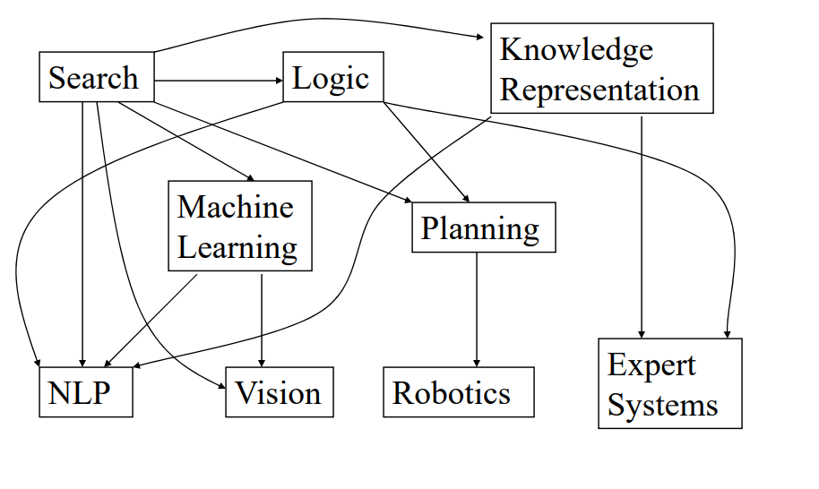
Perspective on NLP:Areas of AI and their inter-dependencies.
Notes:
Artificial Intelligence is forcing function for computer science

Slide 5
Layer 1
Search
Search algorithms try to find out the best possible strategy, the optimal strategy for computer.
Logic
Logic is a vehicle for reasoning and inferencing. In logic we are concerned with several constructs like if x is true then y is true.
C. Knowledge Representation
knowledge must be extracted and embedded in the Machine.

Slide 6
Layer 2
Machine Learning
NLP is using lots of Statistical Techniques. Statistical Techniques are Machine Learning techniques; they make use of the knowledge content in the data.
Planning
Already done in AI

Slide 7
Perspective on NLP:Areas of AI and their inter-dependencies.
NLP-concerned with computer being able to process human language like Hindi, Marathi,Gujrathi,French,English , and understand .
Computer Vision-NLP is followed by Computer Vision where machine processes seen and understand how to operate in seen.
Robotics-there is an embedded software inside robots that asking it to perform certain actions like navigating etc.

Slide 8
Perspective on NLP:Areas of AI and their inter-dependencies.
Expert System-Expert System is concerned with ,the expert level performance of the software on a specific task.
For example –The task could be diagnosis of diseases and curing it.
A doctor is known to operate with number of rules ,a very large no of rules obtained by years of education and practice on patience .
So, the expert system is concerned with emulating this behavior of the expert.

Slide 9
2 nd layer :feeding Layer
Machine Learning and planning feed into a number of layers in the outer most category.
For example, Natural Language Processing is fed by Machine Learning and Natural Language Processing is also fed by Knowledge Representation.
The reason for this is that in current world, Natural Language Processing is using lots of Statistical Techniques.
Statistical Techniques are Machine Learning techniques; they make use of
the knowledge content in the data.

Slide 10
Introduction to Natural Language Processing
Natural language processing (NLP) is a branch of artificial intelligence that helps computers understand, interpret and manipulate human language.
Natural Language Processing, usually shortened as NLP, is a branch of artificial intelligence that deals with the interaction between computers and humans using the natural language.
The ultimate objective of NLP is to read, decipher, understand, and make sense of the human languages in a manner that is valuable.

Slide 11
Natural language processing
It refers to the branch of computer science—and more specifically, the branch of artificial intelligence or AI
concerned with giving computers the ability to understand text and spoken words in much the same way human beings can.
is an interdisciplinary subfield of linguistics, computer science, and artificial intelligence concerned with the interactions between computers and human language

Slide 12

INPUT Text (Document
/Paragraph
/Sentense
/word}
OUTPUT
(Text/ Rating
/Graph
/Audio)
NLP System

Slide 13
Audio
Speech
Processing
Text (Document
/Paragraph
/Sen tense
/word}
OUTPUT
(Text/ Rating
/Graph)
NLP System

Slide 14
Audio
Speech
Processing
Text (Document
/Paragraph
/Sen tense
/word}
OUTPUT
(Text/ Rating
/Graph)
Image
OCR
Processing
NLP System

Slide 15
Stages of Natural language Processing
To converse with human a program must understand the syntax(grammar),semantics(word meaning) and morphology (word level analysis),and pragmatics(conversation).
There are certain phases in which Natural language processing is performed .

Slide 16
Steps in NLP
Morphological Analysis
Word-Level Analysis
Syntactic analysis
Sentence-Level Analysis
Semantic Analysis
Sentence-Level Analysis
Discourse Analysis
Sentence-Level Analysis
Pragmatic Analysis
Sentence-Level Analysis

Slide 17
Morphological Analysis
studies the structure of words or formation of the words.
How words are built from smaller pieces
Identification ,analysis of root words , affixes (suffixes and prefixes)
Example
Washing – wash+ ​ing
Browser – Browse + er
Incomplete- In+ Complete

Slide 18

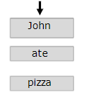
Morphological Analysis
1. Tokenization​
John ate the pizza ! !
2. Stop Word Removal (removing the words that occur commonly across all the documents ,typically, articles and pronouns are generally classified as stop words )​
​

Slide 19
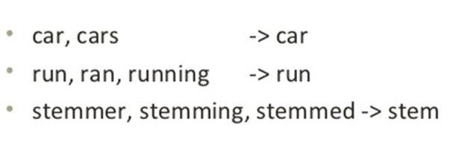
Morphological Analysis
3. Stemming
Stemming is a process of reducing words into its base form (Root form/stem form).
Process of converting infected word to their word stem.
Syntactic analysis
Semantic Analysis
John->John Ate -> eat Pizza->Pizza
Discourse Analysis
Pragmatic Analysis

Slide 20
Lemmatization
text normalization technique used for Natural Language Processing (NLP).
It can convert any word's inflections to the base root form.
For example:
Playing, Plays, Played ------- Play (Common root form "play")

Slide 21
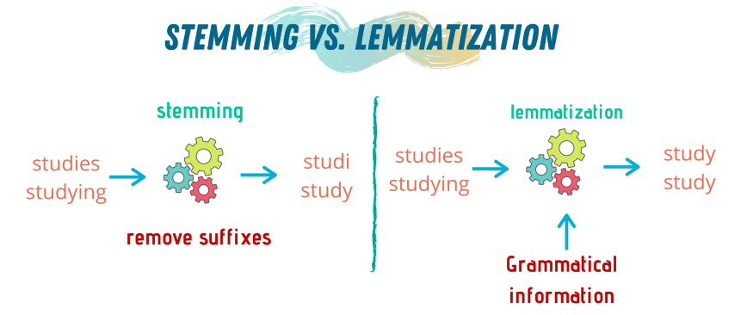
Stemming vs Lemmatization

Slide 22
Stemming vs Lemmatization
S.No | Stemming | Lemmatization
1 | Stemming is faster because it chops words without knowing the context of the word in given sentences. | Lemmatization is slower as compared to stemming but it knows the context of the word before proceeding.
2 | It is a rule-based approach. | It is a dictionary-based approach.
3 | Accuracy is less. | Accuracy is more as compared to Stemming.
4 | When we convert any word into root-form then stemming may create the non-existence meaning of a word. | Lemmatization always gives the dictionary meaning word while converting into root-form.
5 | Stemming is preferred when the meaning of the word is not important for analysis. Example: Spam Detection | Lemmatization would be recommended when the meaning of the word is important for analysis. Example: Question Answer
6 | For Example: “Studies” => “Studi” | For Example: “Studies” => “Study”

Slide 23
Morphological Analysis
4. N-Gram Language Model
Continuous sequence of N-Items from a given sample text.
1-gram-
John
Ate
the
Pizza
Syntactic analysis
Bigram -
John | Ate |  | the | Pizza
Semantic Analysis
Trigram -
John
Ate
the
Pizza
Discourse Analysis
4-Gram -
John Ate the Pizza
Pragmatic Analysis
John Ate the ?

Slide 24
Syntactic analysis
analyzing the grammatical syntax of a sentence to understand its meaning
John Ate the Apple
Ate the Apple John

Slide 25
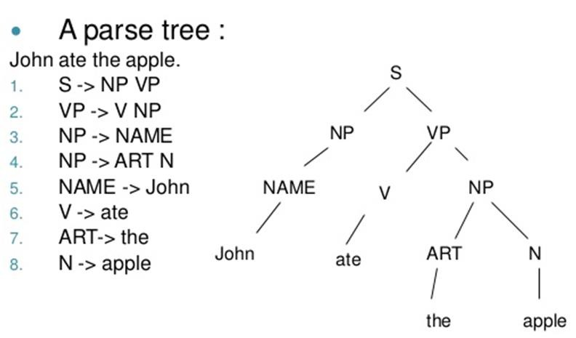
Syntactic analysis set of rules needed to ensure a sentence is grammatically correct
John Ate the Apple
Ate the Apple John

Slide 26
Semantic Analysis
semantics refers to meaning
Morphological Analysis
a computer understands the meaning of a text by analyzing the text as a whole and not just looking at individual words
context in which a word is used is very important
Example 1
Example 2
She drank Some Milk
“Does it all sound like a joke to you?”
Discourse Analysis
Pragmatic Analysis
She drank Some books

Slide 27
Discourse Analysis
Resolving the reference as per the context .
Morphological Analysis
Monkeys Eat Banana, when they Wake up.
Syntactic analysis
Who is they here?
-Monkey
Semantic Analysis
Monkeys eat Banana,
when they are ripe.
Who is they here?
-Banana
Pragmatic Analysis

Slide 28
Pragmatic Analysis
knowledge of the relationship of meaning to the goals and intentions of the speaker.
Morphological Analysis
Syntactic analysis
Close the Door
-Order
Semantic Analysis
Please Close the Door
- Request ,affirmation
Discourse Analysis

Slide 29
Ambiguity in Natural language
input is ambiguous if there are multiple alternative Ambiguous linguistic structures that can be built for it
situation where a word or a sentence may have more than one meaning.
There are different types of ambiguities
Lexical
Syntactical
Semantic
Discourse Ambiguity
Pragmatic Ambiguity

Slide 30

Lexical Ambiguity
is the ambiguity of a single word
It can be resolved by parts of speech tagging
Word has more than one meaning/category
E.g.
Book – Noun –Textbook/Novel
Book – Verb - Book ticket/seat
Bank-Noun –Financial institute
Bank-Noun - River Bank
Bank- Verb- Banking Transaction

Slide 31
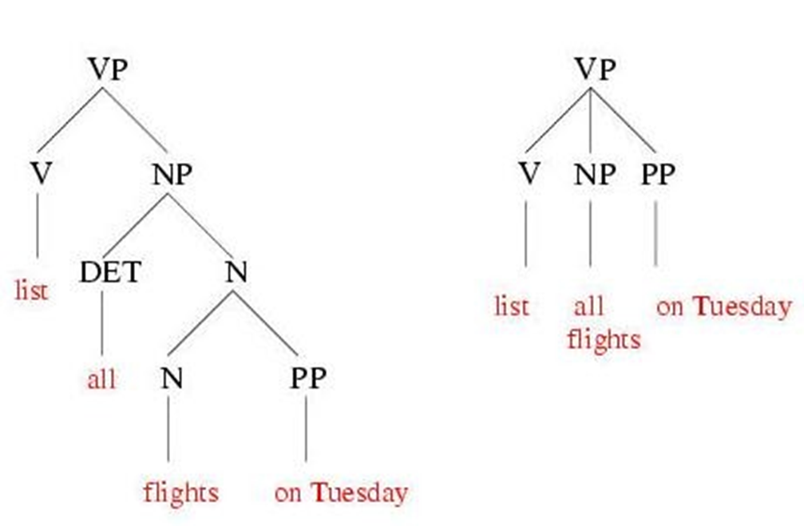
Syntactical Ambiguity(Grammar or rules are ambiguous)
Syntactic Ambiguity exists in the presence of two or more possible meanings within the sentence.
Specify the possible arrangements of words in sentence used
Example
I saw the girl with the binocular.
In the above example, did I have the binoculars? Or did the girl have the binoculars?

Slide 32
Semantic Ambiguity
When a sentence has more than one meaning then it is called as semantic ambiguity
Rahul loves his cat and Dipesh does too.
Whether Dipesh loves his cat or Rahul's cat

Slide 33
Anaphoric Ambiguity
This kind of ambiguity occurs in the sentence due to use of Anaphoric entities in discourse.
Anaphora-When same beginning of sentence is repeated in the sentence several times , we makes the pronoun instead of noun .
For example, My mother liked the house very much , but she couldn't purchase it
Example:-
•Monkeys Eat Banana, when they Wake up. -Who is they here? Monkey
•Monkeys eat Banana, when they are ripe.-Who is they here?-Banana
Identify When, Where, by whom occurrence was said

Slide 34
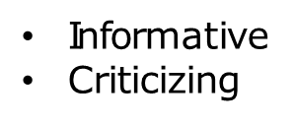
Pragmatic Ambiguity
Understanding speaker's intention.
Eg. You are Late

Slide 35
Challenges in NLP
Elongated words
I am sooooo sorry.
It was toooo yummy.
Shortcuts
Pls -
BTW -
Wat -
K -
Please
By the way What
OK

Slide 36
Challenges in NLP
Emojis

Slide 37
Challenges in NLP
Mix Use of Languages
I liked that movie. Salman khan ka acting was Lajabab. Too good. जबरदस्त.

Slide 38
Challenges in NLP
Ellipsis
Peter worked hard and passed exam, Kevin too.
Interpretation
Kevin worked hard
Kevin passed exam
Kevin worked hard also he passed exam

Slide 39
Challenges in NLP
Punctuational Ambiguity
Women, without her man, is nothing.
Women! without her, man is nothing.

Slide 40

Applications of NLP
1. Question Answering
Question Answering focuses on building systems that automatically answer the questions asked by humans in a natural language.

Slide 41
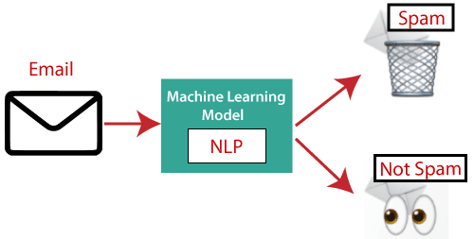
Applications of NLP
2. Spam Detection
Spam detection is used to detect unwanted e-mails getting to a user's inbox.

Slide 42

3. Sentiment Analysis
This application is implemented through a combination of NLP (Natural Language Processing) and statistics by assigning the values to the text (positive, negative, or natural), identify the mood of the context (happy, sad, angry, etc.)​
This application is implemented through a combination of NLP (Natural Language Processing) and statistics by assigning the values to the text (positive, negative, or natural), identify the mood of the context (happy, sad, angry, etc.)​

Slide 43
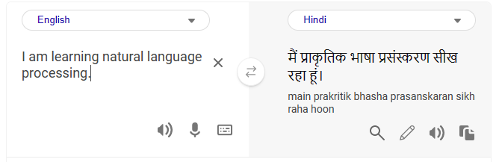
4. Machine Translation (Example: Google Translator)
Machine translation is used to translate text or speech from one natural language to another natural language.

Slide 44
5. Spelling correction
Microsoft Corporation provides word processor software like MS-word, PowerPoint for the spelling correction.
Chek's the spelling while typing.
Example Wrong Speling will be underlined with the red color as done in this sentence

Slide 45
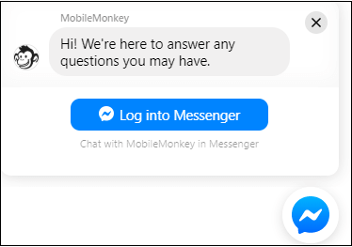
6. Chatbot
Implementing the Chatbot is one of the important applications of NLP. It is used by many companies to provide the customer's chat services.

